Slide 1
Informed/Heuristic search and Exploration
Fundamentals of Artificial Intelligence
Slides are mostly adapted from AIMA, MIT Open Courseware and
Svetlana Lazebnik (UIUC)
Spring 2008

Slide 2
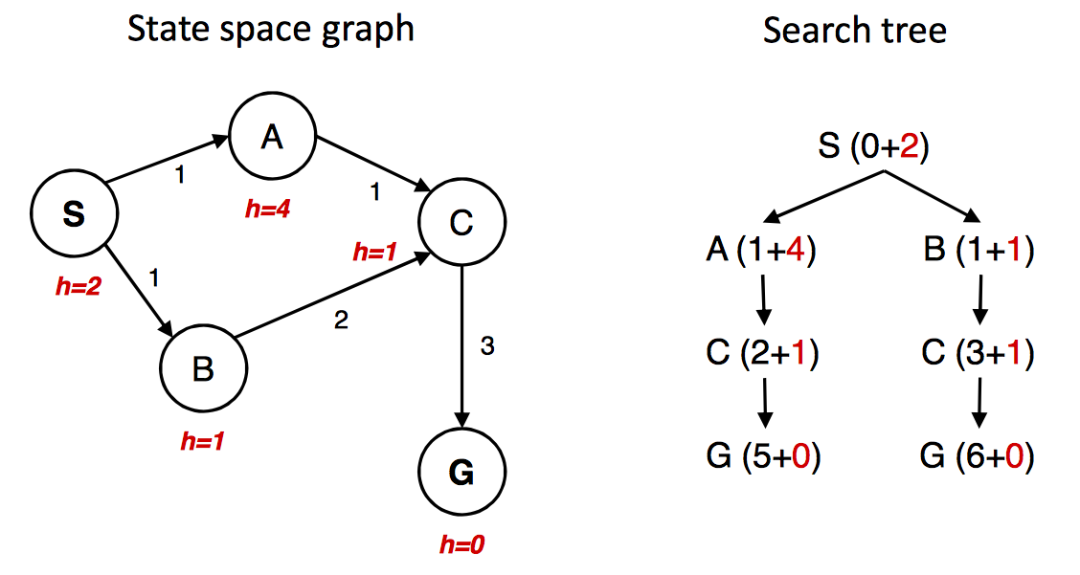
A* gone wrong?
Source: Berkeley CS188x
Notes:
Upto now A* seems to be perfect
Let’s see one more example
From S We reach A with 1+4 and B with 1+1
So we choose B
Then, we reach C with 3 + 1 = 4
Now we continue by expanding C ,and reach G by 6+0 = 6
But we have a cheaper node in the queue A, then we expand it
So from A we reach C again with 2+1 = 3
Then from C we reach G by 5+0 = 5
What happened here?
Why we chose he wrong path at the beginning?

Slide 3
Admissible heuristics
An admissible heuristic never overestimates the cost to reach the goal, i.e., it is optimistic
A heuristic h(n) is admissible if for every node n,
h(n) ≤ h*(n), where h*(n) is the true cost to reach
the goal state from n
Consequence: f(n) never over estimates the the true cost of a solution through n since g(n) is the exact cost to reach n
Example: straight line distance never overestimates the actual road distance
Theorem: If h(n) is admissible, A* is optimal
Notes:
We used the given heuristics but did not talk about how we choose them.
Now, let’s see the properties of heuristics
We call an heuristic admissible if it never overestimates the true cost to reach to the goal.
If we denote the true cost to reach to the goal as h*, then we expect h(n) <= h*(n) for every node n
Note here that straight line distance never overestimates the actual road distance

Slide 4
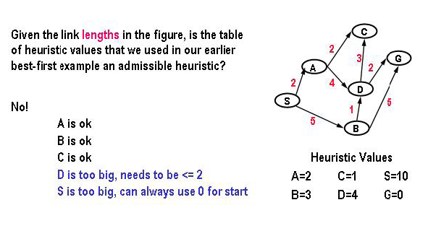
Not all heuristics are addmissible
Spring 2008
Notes:
One another example
From S we generate A with 2+2 = 4 and B with 5+3 = 8
We expand A
Then we generate C with 4+1 = 5 and D with 6 + 4 = 10
Then we expand C, which is a dead end
So we expand B
Then generate D with 6+4 = 10 again, and G with 10+0 = 10
We expand G
The path found is S B G
However it costs 10, while we have a shorter path from B D G with cost 8
What happened here?
Let’s look at whether the heuristics are admissible
h(A) = 2 which is less than the true distance 6 so it is admissible
h(B) = 3 which is less than the true distance 5 so it is admissible
C is admissible but useless to reach G
D is not admissible because h(D) = 4 which is larger than true distance 2
Since not all heuristics are not admissible A* is not optimal in this case.

Slide 5
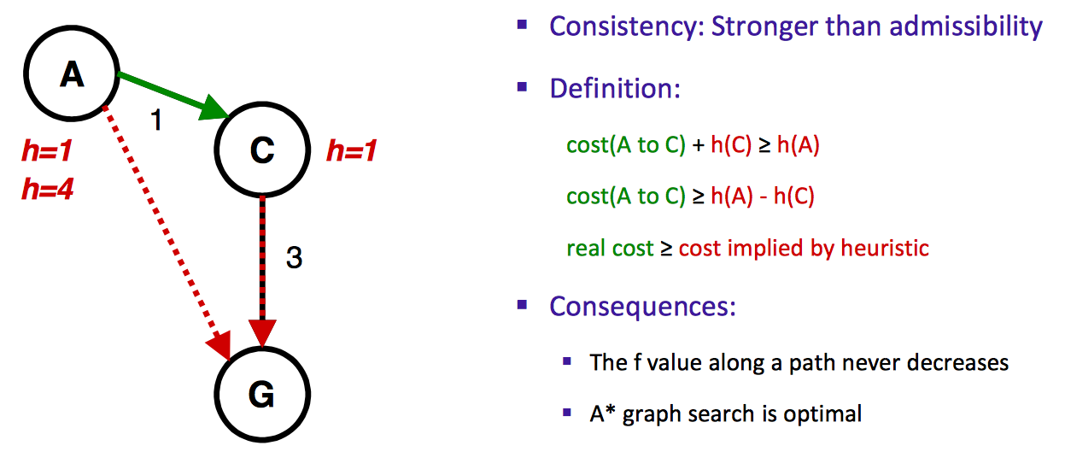
Consistency of heuristics
h=4
Source: Berkeley CS188x

Slide 6

Consistent heuristics
A heuristic is consistent if for every node n, every successor n' of n generated by any action a,
h(n) ≤ c(n,a,n') + h(n')
n' = successor of n generated by action a
The estimated cost of reaching the goal from n is no greater than the step cost of getting to n' plus the estimated cost of reaching the goal from n'
If h is consistent, we have
f(n') = g(n') + h(n')
= g(n) + c(n,a,n') + h(n')
≥ g(n) + h(n)
≥ f(n)
if h(n) is consistent then the values of f(n) along any path are non-decreasing
Theorem: If h(n) is consistent, A* using GRAPH-SEARCH is optimal
Spring 2008

Slide 7
Optimality of A*
Tree search (i.e., search without repeated state detection):
  A* is optimal if heuristic is admissible (and non-negative)
Graph search (i.e., search with repeated state detection)
  A* optimal if heuristic is consistent
Consistency implies admissibility
  In general, most natural admissible heuristics tend to be consistent, especially if they come from relaxed problems
Source: Berkeley CS188x

Slide 8

Optimality of A*
Monotonicity: A* expands nodes in order of increasing f value
Gradually adds "f-contours" of nodes
Contour i has all nodes with f=f_{i}, where f_{i} < f_{i+1}
A* expands all nodes with f(n) < C*
A* might then expand some of the nodes right on the goal contour (where f(n) = C*) before selecting a goal state
A* expands no nodes with f(n) > C* (e.g. the subtree under Timisoara)
Spring 2008
Notes:
Monotonicity: Along any path from the root the f-cost never decreases
If f never decreases along any path from the root we can conceptually draw contours in the state space
Inside the contour labeled 400 all nodes have f(n) less than or equal to 400, and so on
A* search fans out from the start node, adding nodes in concentric bands of increasing f-cost
With uniform cost search (A* search with h=0) the bands will be circular.
With more accurate heuristics the bands will stretch toward the goal state and become more narrowly focused around the optimal path
A8 expands all nodes with f(n) < C*
A* may expand some nodes right on the goal contour, f(n) = c*
The first solution found must be the optimal one
Because nodes in all subsequent contours will have higher f-cost, and since all goal states has h=0 higher g costs

Slide 9
Optimality of A*
Theorem: If the heuristic is admissible, A* without repeated state detection is optimal
Proof sketch:
  Let C* be the evaluation function value (actual path cost) of the first goal node we select for expansion
  Then all the other nodes on the frontier have estimated path costs to the goal that are at least as big as C*
  Because we are using an admissible heuristic, the true path costs to the goal for those nodes cannot be less than C*
start
n
frontier
Estimated path costs
to goal
Actual
path costs
to goal

Slide 10

Optimality of A* (proof)
Suppose some suboptimal goal G₂ has been generated and is in the fringe. Let the cost of the optimal solution to goal G is C*
  f = g + h
f(G₂) = g(G₂) since h(G₂) = 0
g(G₂) > C* since G₂ is suboptimal
f(G) = g(G) since h(G) = 0
f(G₂) > f(G) from above
Spring 2008
Notes:
Let g be an optimal goal state with path cost C*
Let G2 be a suboptimal goal state with path cost g(G20 > C*
We assume that A* has selected G2 from the queue and since G2 is a goal state this would terminate the search with a suboptimal solution
We will show that this is not possible
Consider a node n that is currently a leaf node on an optimal path to G
Since h is admissible we must have C* >=f(n)
If n is not chosen for expansion over G2 we must have
F(n) > = f(G2)
Combining together we get
C* <= f(G2)
But because G2 is a goal state h(G2) = 0 hence f(G2) = g(G2)
Thus we prove that
C8 > = g9G2)
This contradicts the assumption that G2 is suboptimal
So A* never selects a suboptimal goal for expansion

Slide 11
Optimality of A* (proof)
Let n be an unexpanded node in the fringe such that n is on a shortest path to an optimal goal G (e.g. Pitesti).
If h(n) does not overestimate the cost of completing the solution path, then
f(n) = g(n) + h(n) ≤ C*
f(n) ≤ f(G)
f(G₂) > f(G) from above
Hence f(G₂) > f(G) >= f(n) , and A* will never select G₂ for expansion
Spring 2008

Slide 12
Optimality of A*
A* is optimally efficient – no other tree-based algorithm that uses the same heuristic can expand fewer nodes and still be guaranteed to find the optimal solution
  A* expands all nodes for which f(n) ≤ C*. Any algorithm that does not risks missing the optimal solution

Slide 13
Properties of A*
Complete? Yes (unless there are infinitely many nodes with f ≤ f(G)
Time? Exponential
Space? Keeps all nodes in memory
Optimal? Yes
Alternative:
  Memory bounded heuristic search :
    IDA*: adapt the idea of iterative deepening search, use cut-off as f-cost rather than the depth.
    Recursive best-first search
Spring 2008
Notes:
A* is complete
As we add bands of increasing f we must eventually reach a band where f is equal to the cost of the path to a goal state

Slide 14

Admissible heuristics
E.g., for the 8-puzzle:
h₁(n) = number of misplaced tiles
h₂(n) = total Manhattan distance – the sum of the distances of the tiles from their goal positions
h₁(S) = ?
h₂(S) = ?
Spring 2008
Notes:
Let’s consider some other heuristics for other real world problems
The objective of 8-puzzle is to slide the tiles horizontally or vertically into the empty space until the configuration matches the goal configuration.
Consider two heuristics for 8 puzzle that never overestimates the number of steps to the goal.
The first heuristic is the number of tiles that are in the wrong position
The second one is the sum of th edistances of the tiles from their goal position

Slide 15
Admissible heuristics
E.g., for the 8-puzzle:
h₁(n) = number of misplaced tiles
h₂(n) = total Manhattan distance
h₁(S) = ? 8
h₂(S) = ? 3+1+2+2+2+3+3+2 = 18
Spring 2008
Notes:
As you see all of the eight tiles are in wrong position, so H1= 8
Is it admissible, yes.
Because it is clear that any tile that is out of place must be moved at least once
For h2, we find the distances using Manhattan or city block distance.
So in order to put the tile into its correct place, we can move it horizontally or vertically in any step
For 1 we have to move 2 vertically, and then 1 to the left
For 2 only 1 to right
For three 1 up and one left
And so on
So we need 3+1+2+2+2+3+3+2 = 18 moves
This is our h2
Is it admissible yes
Because any move can only move one tile one step closer to the goal
S

Slide 16
Quality of a heuristic
Effective branching factor b*
If N is the number of nodes generated by A*, and the solution depth is d, then
  N+1 = 1 + b* + (b*)^2 + … + (b*)^d
E.g. If A* finds a solution at depth 5 using 52 nodes, then b* = 1.92
The average solution cost for randomly generated 8-puzzle instance is about 22 steps. The branching factor is 3 (when the tile is in middle it is 4, when in the corner it is 2, when it is along the edge it is 3)
Typical search costs (average number of nodes expanded):
d=12 IDS = 3,644,035 nodes
A*(h₁) = 227 nodes, b* =1,42
A*(h₂) = 73 nodes, b* = 1.24
d=24 IDS = too many nodes
A*(h₁) = 39,135 nodes, b* = 1.48
A*(h₂) = 1,641 nodes, b* = 1.26
Spring 2008
Notes:
Let’s now look at the effect of the heuristics on the performance
We can characterize the quality of a heuristic by the effective branching factor which is
The total number of expanded nodes divided by the depth of the solution
For example if A* finds a solution at depth 5 with 52 nodes, then the effective bracnching factor is 1.91
A well designed heuristic would have a value b* close to 1
Let’s look at the 8 puzzle problem with two heuristics
For depth 12
with h1 227 nodes are generated with effective branching factor 1.42
And
with h2 73 nodes are generated with effective branching factor 1.24
For depth 24
with h1 39,135 nodes are generated with effective branching factor 1.48
And
with h2 1,641 nodes are generated with effective branching factor 1.26
For iterative deepening search the numbers are much higher
Note that h2 is better than h1 in both cases.

Slide 17
Dominance
If h₂(n) ≥ h₁(n) for all n (both admissible)
then h₂ dominates h₁
h₂ is better for search
It is always better to use a heuristic function with higher values, provided it does not overestimate and that the computation time for the heuristic is not too large
Why?
Every node with f(n) < C* will be expanded
i.e. every node with h(n) < C* - g(n) will be expanded
Since h2 is at least as big as h1 for all nodes, every node that is expanded by h2, will be also expanded by h1, and h1 may also cause other nodes to be expanded
Spring 2008
Notes:
Is h2 always better than h1, Yes
It is easy to see that for any node h2(n) > = h1(n)
We say that h2 dominates h1
And it is related to the efficiency
A* using h2 will expand fewer nodes, on average than A* using h1
Recall that
Every node with f(n) < C* will be expanded
This is the same as saying that every node with h(n) < C* - g(n) will be expanded
If h2 is at least as big as h1 for all nodes, every node that is expanded by using h2 will also be expanded by using h1
But h1 may also cause other nodes to be expanded as well
Hence
It is always better to use a heuristic function with higher values, as long as it does not overestimate

Slide 18
Inventing admissible heuristic functions
h1 and h2 estimates perfectly accurate path length for simplified versions of 8-puzzle
If a tile can move anywhere, then h1 would give the exact number of steps in the shortest solution.
If a tile can move to any adjacent square, even onto an occupied square, then h2 would give the exact number of steps in the shortest solution.
Spring 2008
Notes:
We have seen that both h1 and h2 are good heuristics for 8 puzzle and h2 is better
But how can we invent heuristic functions?
We can consider both h1 and h2 as the accurate path lengths for simplified versions of 8-puzzle
If the tile can move anywhere instead of just to an adjacent empty square then h1 would give the number of steps to the shortest solution
Similarly if a tile could move one square in any direction, even onto an occupied square then h2 would give the exact solution.

Slide 19
Relaxed problems
A problem with fewer restrictions on the actions is called a relaxed problem
The cost of an optimal solution to a relaxed problem is an admissible heuristic for the original problem
The heuristic is admissible because the optimal solution in the original problem is also a solution in the relaxed problem and therefore must be at least as expensive as the optimal solution in the relaxed problem
Spring 2008
Notes:
A problem with less restrictions is called a relaxed problem
The cost of an exact solution to a relaxed problem is a good heuristic for the original problem

Slide 20
Inventing admissible heuristic functions
If a problem definition is written down in a formal language, it is possible to construct relaxed problems automatically (ABSOLVER)
  If 8-puzzle is described as
    A tile can move from square A to square B if
      A is horizontally or vertically adjacent to B and B is blank
  A relaxed problem can be generated by removing one or both of the conditions
    (a) A tile can move from square A to square B if A is adjacent to B
    (b) A tile can move from square A to square B if B is blank
    (c) A tile can move from square A to square B
  h2 can be derived from (a) – h2 is the proper score if we move each tile into its destination
  h1 can be derived from (c) – it is the proper score if tiles could move to their intended destination in one step
Admissible heuristics can also be derived from the solution cost of a subproblem of a given problem
Spring 2008

Slide 21
Heuristics from subproblems
Let h₃(n) be the cost of getting a subset of tiles
(say, 1,2,3,4) into their correct positions
Can precompute and save the exact solution cost for every possible subproblem instance – pattern database

Slide 22
Combining heuristics
Suppose we have a collection of admissible heuristics h₁(n), h₂(n), …, h_{m}(n), but none of them dominates the others
How can we combine them?
h(n) = max{h₁(n), h₂(n), …, h_{m}(n)}
Notes:
It is difficult to get one clearly best heuristic
If a collection of admissible heuristics h1…hm are available for a problem and none of them dominates any of the others
We can use h(n) as max {h1….hm}
It uses whichever function is most accurate on a node

Slide 23
Weighted A* search
Idea: speed up search at the expense of optimality
Take an admissible heuristic, “inflate” it by a multiple α > 1, and then perform A* search as usual
Fewer nodes tend to get expanded, but the resulting solution may be suboptimal (its cost will be at most α times the cost of the optimal solution)

Slide 24
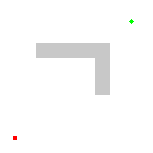
Example of weighted A* search
Heuristic: 5 * Euclidean distance
from goal
Source: Wikipedia
Compare: Exact A*
Notes:
left weighted A*
Right original A*

Slide 25
All search strategies
Algorithm | Complete? | Optimal? | Time complexity | Space complexity
BFS
DFS
IDS
UCS
Greedy
A*
Yes
If all step
costs are equal
O(b^{d})
O(b^{d})
No
No
O(b^{m})
O(bm)
Yes
If all step
costs are equal
O(b^{d})
O(bd)
Yes
Yes
Number of nodes with g(n) ≤ C*
Worst case: O(b^{m})
No
No
Best case: O(bd)
Yes
(if heuristic is
admissible)
Yes
Number of nodes with g(n)+h(n) ≤ C*

